Slide 1
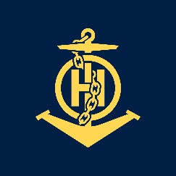
Lessons and experience gained during and after the Cat B course
IHO – NIPPON FOUNDATION
ALUMNI SEMINAR
Godwin Borg

Slide 2
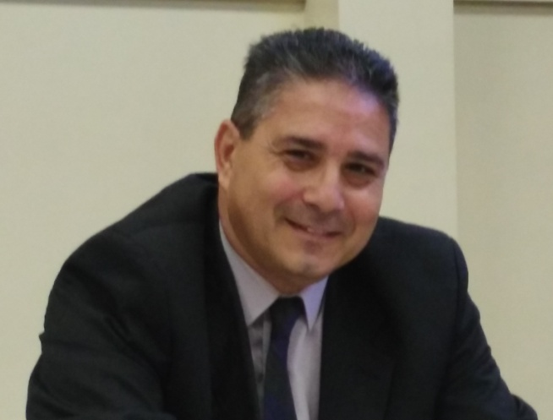
Self introduction
IHO – NIPPON FOUNDATION
ALUMNI SEMINAR
Name | Godwin Borg
Alumni year | 2018
Country | Malta
Organization | Transport Malta HO
Position/Job title | Cartographer
Current job description | Work on Enc and Paper chart Hydrographic surveys and post processing of data
Please put your photo here!

Slide 3
My career path and projects / Achievements
IHO – NIPPON FOUNDATION
ALUMNI SEMINAR
2000 assigned to the Hydrographic section
2006 Electronic Nautical Cartography at the International Maritime Academy Trieste Italy
2007 Hydrographic Survey Course Solent University Southampton
2017 First MT cell published

Slide 4
Lessons learned from CHART Course
IHO – NIPPON FOUNDATION
ALUMNI SEMINAR
The art of making electronic and paper charts to IHO international standards.
The use of related software and tools.
Validation and Quality control.
Paper chart and Enc updates.
The importance of Notices To Mariners and Nautical Publications for the mariner.
Maritime Law.
Meeting other HOs and share experiences.

Slide 5
Suggestion for the future
IHO – NIPPON FOUNDATION
ALUMNI SEMINAR
My experience gained from this course will be transmitted to the hydrographic office and future cartographers, this will also have a good impact on our end products.
Malta HO is currently small compared to other HO’s but I hope that my knowledge will help us to develop our HO structure and expand in the near future.
Be able to take my office through the S-10X era.

Slide 6
My thanks for attending the 10th Cartographic B course of the Nippon Foundation
IHO director Mustafa Iptes
Nippon Foundation
UKHO Jeff Bryant and Lucy Fieldhouse and their Team
Capt. David Bugeja and Mr. Joseph Bianco from Transport Malta

